Slide 1
Deep Neural Networks
Parameters vs
Hyperparameters

Slide 2
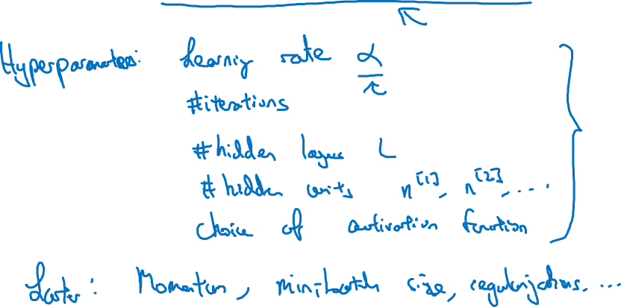
What are hyperparameters?

Slide 3
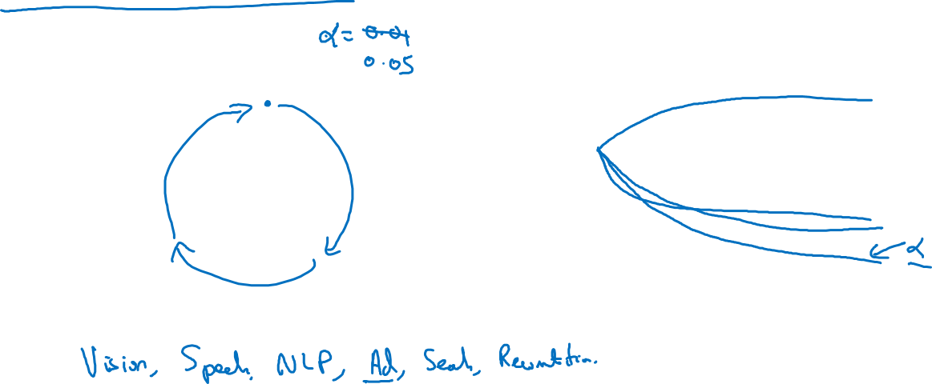

Applied deep learning is a very empirical process
Idea
cost
Experiment
Code
# of iterations

